Slide 1

Final Presentation Of Health Inequity in Salt Lake County
Professional Master of Science and Technology Professional Experience Project
Grace Tan
Apr 27, 2022

Slide 2
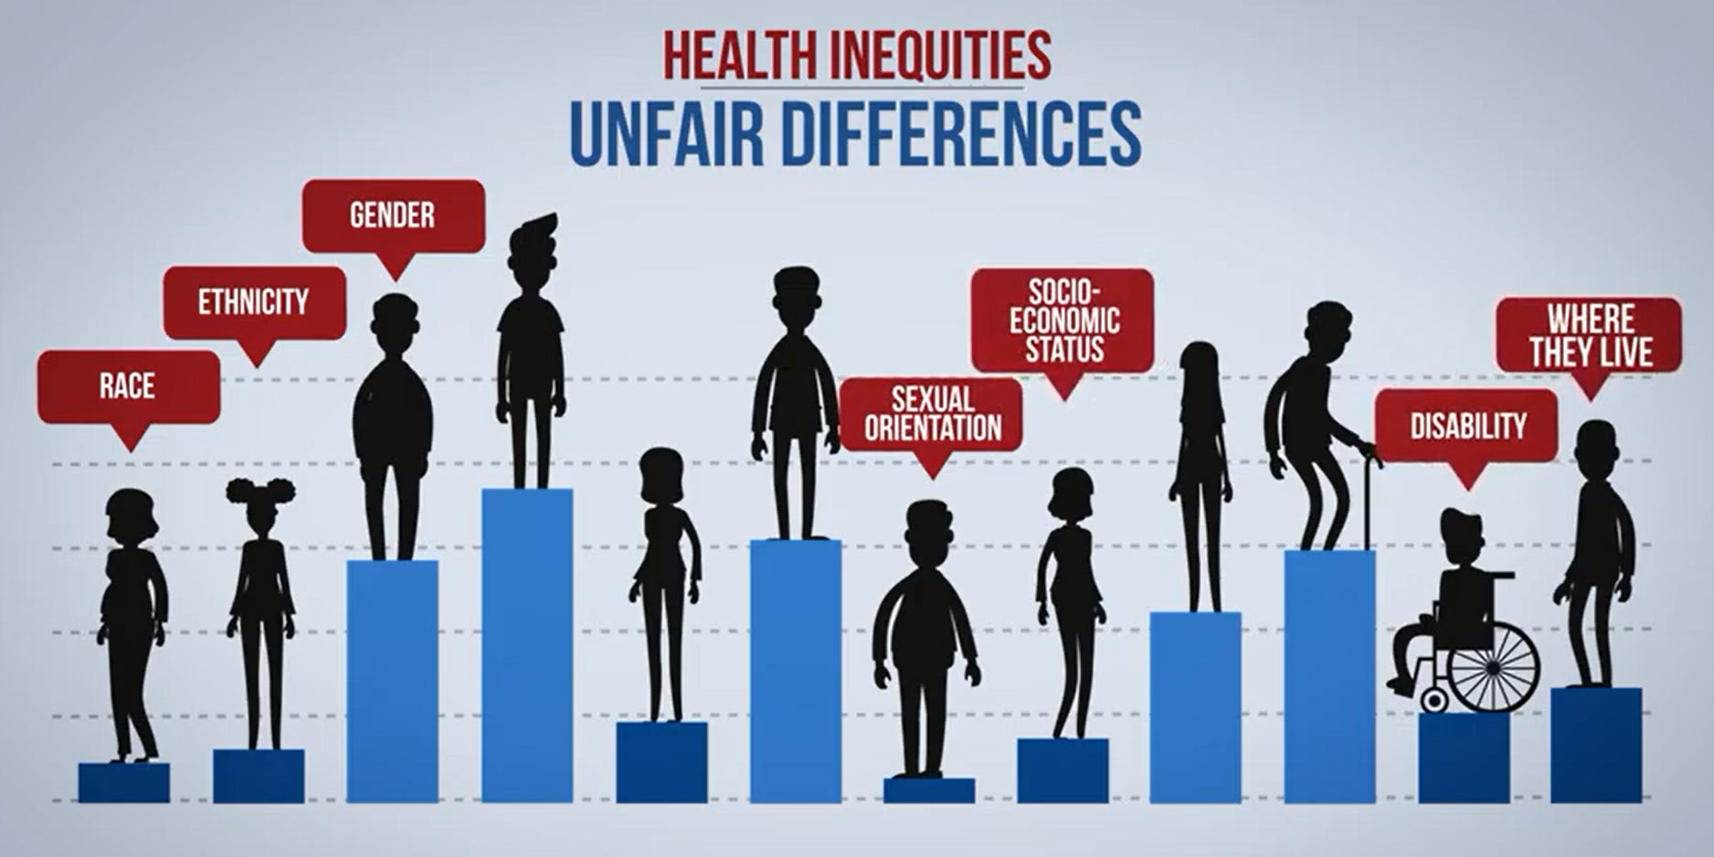
CONTENTS
1
Background and Introduction
2
Dataset and Methods
3
Problems and Solutions in Analysis
4
Empirical Research
5
Discussion
6
Conclusions
7
References
Source: Engaging Healthcare Teams to Eliminate Health Inequities

Slide 3
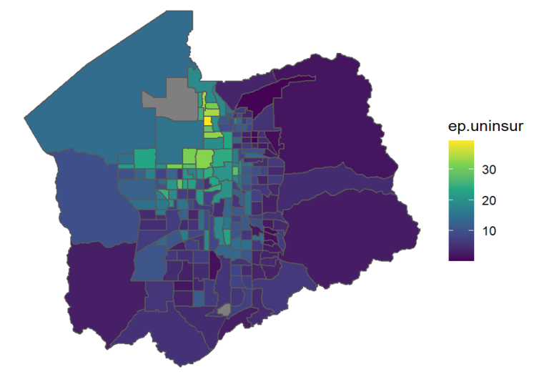
1 Background and Introduction
1.1
Why the topic?
1.2
Definitions of Equity
1.3
Project Introduction
Figure: The Uninsured Percentage in Salt Lake County

Slide 4
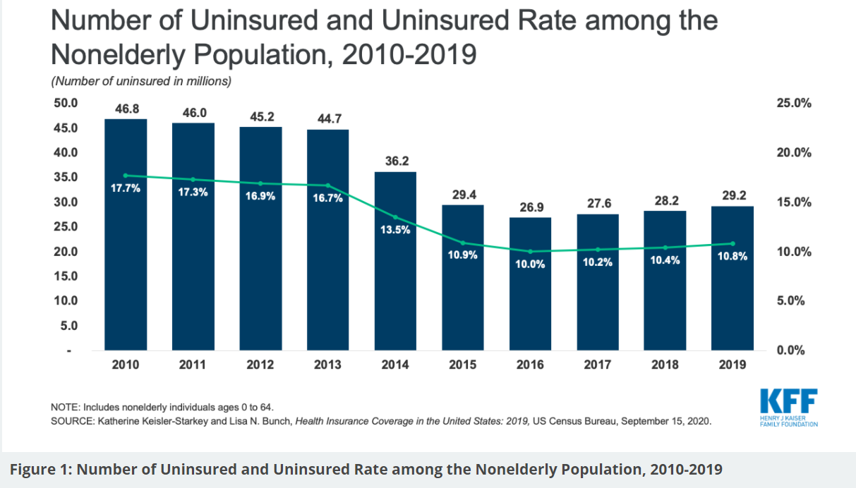
1.1.1 Why the topic?
• Medical services reflect the basic need of individuals.
• After historic declines in the number of uninsured people and the uninsured rate following the adoption and implementation of the 2010 Affordable Care Act (ACA), resulting in nearly 20 million more people covered through 2016, the number and rate of nonelderly uninsured people began to increase in 2017.
Source: What We Do and Don’t Know About Recent Trends in Health Insurance Coverage in the US

Slide 5
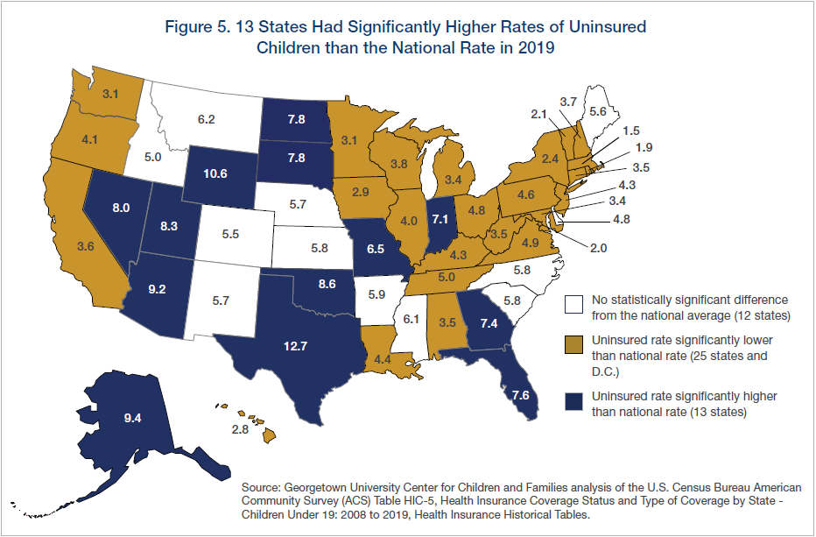
1.1.2 Why the topic?
According to recent census data, Utah has 82,000 children without health insurance. An estimated 8.3% of children in Utah do not have health insurance, and the state ranks 46th — among the worst in the country — for rates of uninsured children.
Source: Utah has one of the highest rates of uninsured kids. Could insuring them save taxpayers millions?

Slide 6
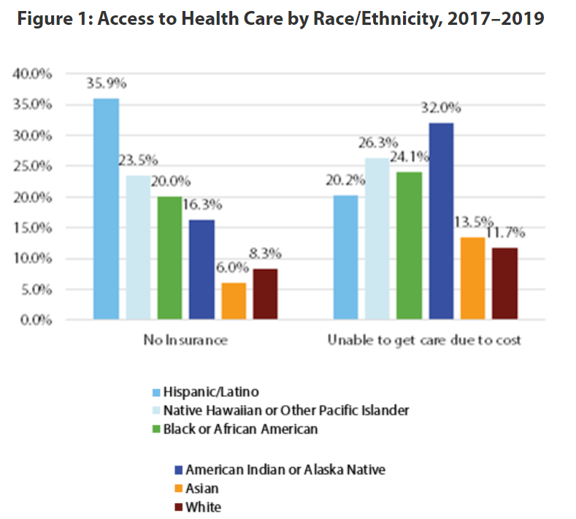
1.1 Why the topic?
1
As COVID-19 continues to spread, data reveal unequal impacts across population groups. The Hispanic/Latino population is Utah’s largest minority group. While they make up 14.2% of the state’s population, they account for 29.5% of COVID-19 cases and 20.9% of COVID-19 deaths.
2
Health care access and utilization—Health insurance rates vary widely by race/ethnicity as seen in Figure 1. More than 35% of Utah’s Hispanic/Latino population has no health insurance, compared with only 8.3% of the white population. Additionally, Figure 1 shows that cost frequently prohibits minority populations from receiving needed care.
Source: Utah Department of Health 2017–2019 Behavioral Risk Factor Surveillance System (BRFSS) Data

Slide 7
1.2 Definitions of Equity
1
Equity in health care can mean equal utilization, distribution according to need, equal access, equal health outcomes (Culyer &Wagstaff 1993 (24)).
2
Margaret Whitehead put the definition of health equity in The Concepts and Principles of Equity in Health that: "as equal access to available care for equal need, equal utilization for equal need, equal quality of care for all."
3
She held the view on health inequity that "are not only unnecessary and avoidable but, in addition, are considered unfair and unjust."

Slide 8
1.3 Project Introduction
1
We use publicly available datasets for this project, including the American Community Survey 5-Year data (2015-2019), the CDC/ATSDR Social Vulnerability index, and Area Deprivation Index (ADI), to explore healthcare inequity in Salt Lake County. These datasets provide information at the census tract level.
2
Due to limited use of the public dataset, I don't have specific data to reflect health services. For example, how many times does one person go to the hospital one year? How much money have they spent on it? I adopt the health insurance percentage as the proxy for healthcare equity in the project.
According to SVI 2018 Documentation-H, we draw the graph to show the uninsured percentage by tracts in Salt Lake County.

Slide 9
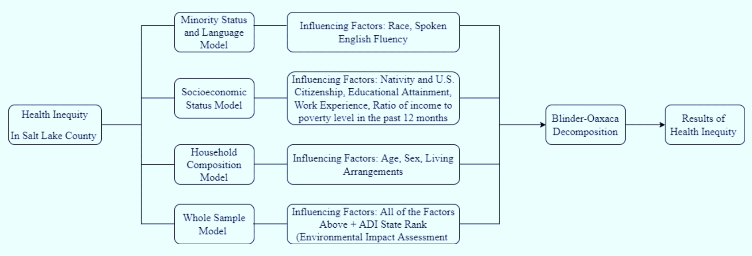
2 Dataset and Methods
2.1
Dataset
2.2
Methods
Figure: Project Analysis Framework

Slide 10
2.1.1 Public datasets
1
The American Community Survey 5-Year data (2015-2019)
Most of the datasets in the project are from The American Community Survey 5-Year Data (ACS 5). We extract 26 columns under subjects "S2701_C05_***".
2
The CDC/ATSDR Social Vulnerability Index
The CDC/ATSDR Social Vulnerability Index (CDC/ATSDR SVI) uses 15 U.S. census variables to help local officials identify communities that may need support before, during, or after disasters. I extract "EP_LIMENG“ (percentage of persons who speak English less than well)
3
The Area Deprivation Index (ADI)
ADI "allows for rankings of neighborhoods by a socioeconomic disadvantage in a region of interest (e.g., at the state or national level). It includes factors for the theoretical domains of income, education, employment, and housing quality.” I extract "ADI_STATERNK" .

Slide 11
2.1.2 Dataset Structure (1)
We have the dataset with 28 columns, including 26 columns from census data, 1 column from SVI, and 1 column from ADI.
I find the percent uninsured by tracts on the 80th percentile (15.86%) and split the tracts into two groups. The tracts with a percent uninsured by tracts higher than 15.86% are in risk group 1. Other tracts are in the safe group 0. I generate a column called "rank80," which indicates the group "0" and "1".

Slide 12
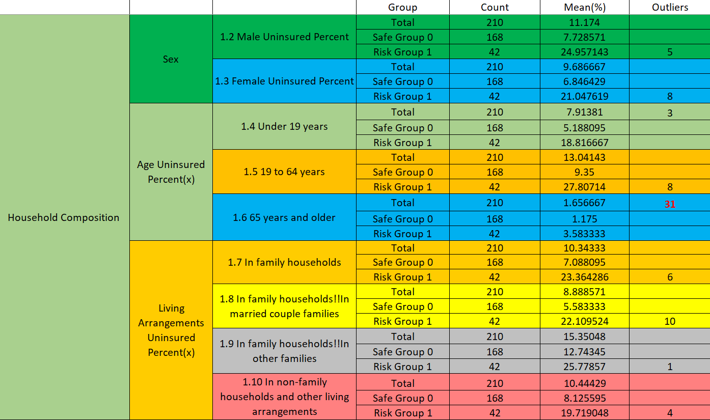
2.1.2 Dataset Structure (2)

Slide 13
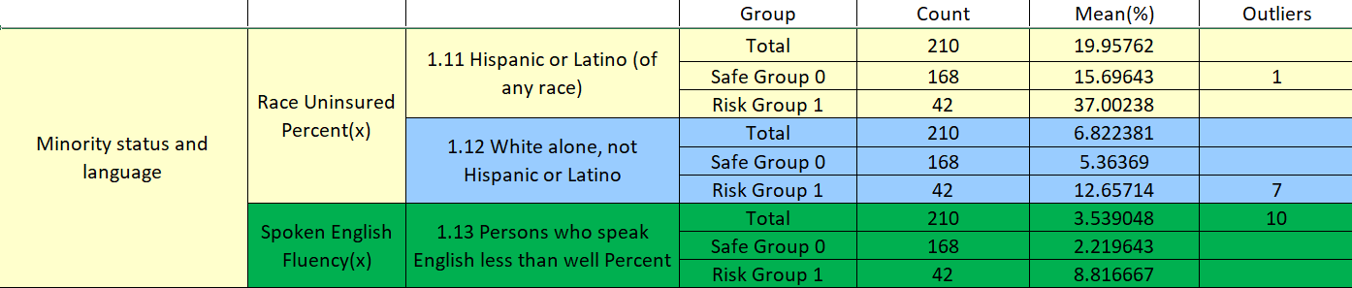
2.1.2 Dataset Structure (3)

Slide 14
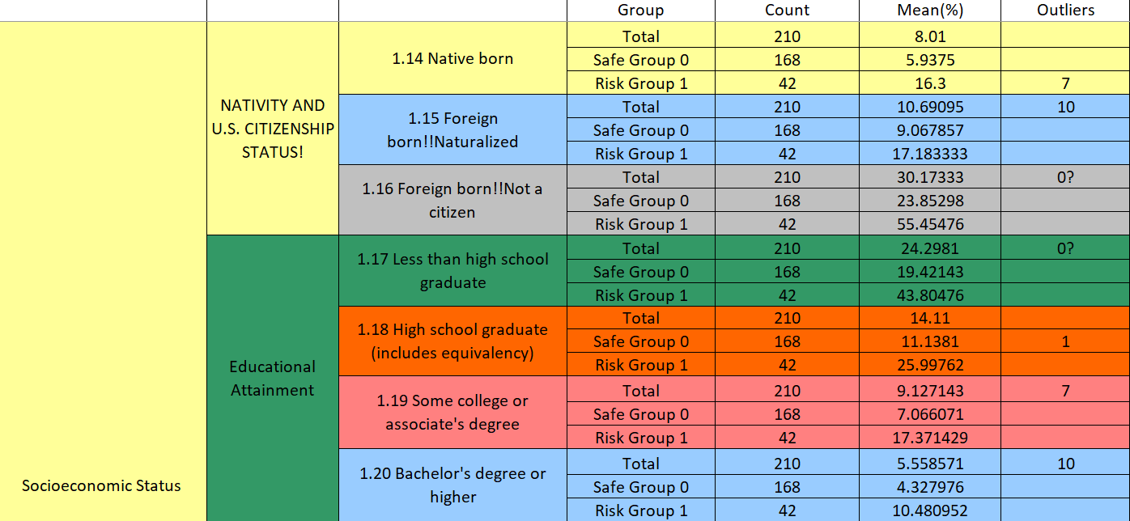
2.1.2 Dataset Structure (4.1)

Slide 15
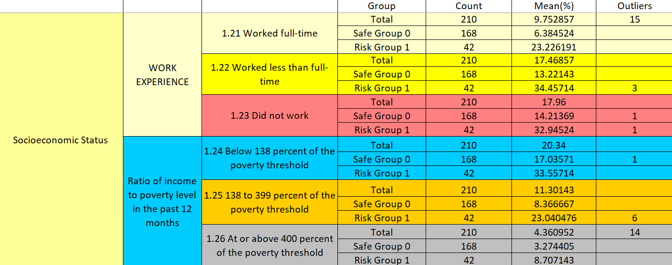
2.1.2 Dataset Structure (4.2)

Slide 16
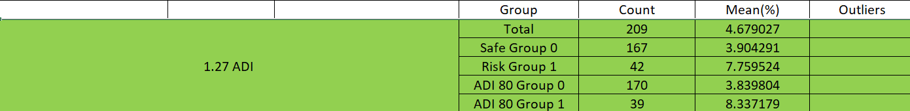
2.1.2 Dataset Structure (5)
I find ADI state rank on the 80th percentile which is 7 and split the tracts into two groups. The tracts with ADI state rank higher than 7 are in poor living environment group 1. Other tracts are in the safe group 0. I generate a column called "ADI80," which indicates the group "0" and "1".
There are 212 tracts in Salt Lake County. I deleted the rows from GEOID "49035112818" and "49035980000" because we missed all ACS data from these two tracts.
Then our dataset for this project has 210 rows and 30 Columns. Notice that we miss the value in the ADI table from GEOID 49035101400. When our models exclude the "ADI80" value, we have 210 entries in dataset 4. When our model includes the "ADI80" value, we have 209 entries in dataset 4.1.

Slide 17
2.2.1 Process of Statistic Analysis
Figure: Project Analysis Framework
Notes:
Empirical research will study how the minority status and language have an impact on y, how socioeconomic status has an impact on y, how the household composition has an impact on y, how minority status and language, socioeconomic status, household composition, environmental impact assessment combined have an impact on y. We will work on descriptive statistics, correlation analysis, linear regression analysis, regression diagnosis, and Oaxaca decomposition in every small and combined model. I will present the results and discussion.
At the end of the empirical research, I will draw a conclusion.

Slide 18
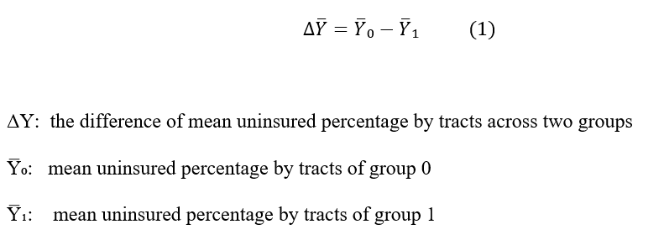
2.2.2 Introduction: Blinder-Oaxaca Decomposition
1
Blinder-Oaxaca decomposition
I refer to “Oaxaca: Blinder-Oaxaca Decomposition in R” by Marek Hlavac and adopt Blinder-Oaxaca Decomposition as the project model.
The Blinder-Oaxaca decomposition is a statistical method widely used to analyze types of inequity in sociology research across any two groups.
In the project, I label the two groups as Group 0 (safe group) and Group 1 (risk group).

Slide 19
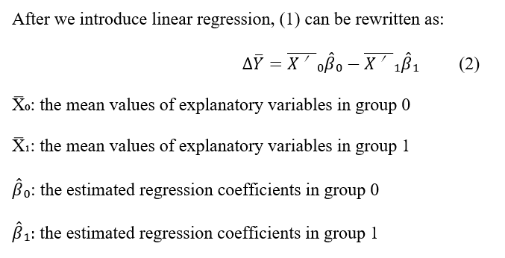
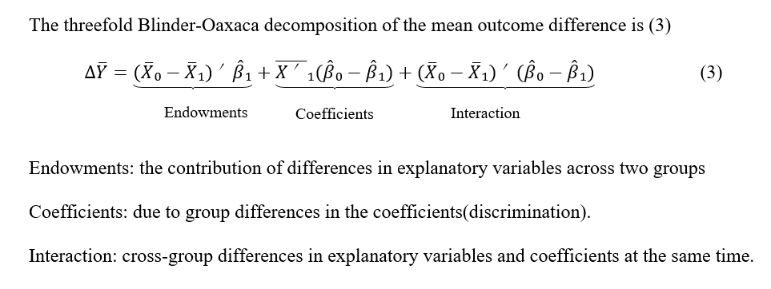
2.2.2 Introduction: Blinder-Oaxaca Decomposition
2
Threefold decomposition

Slide 20
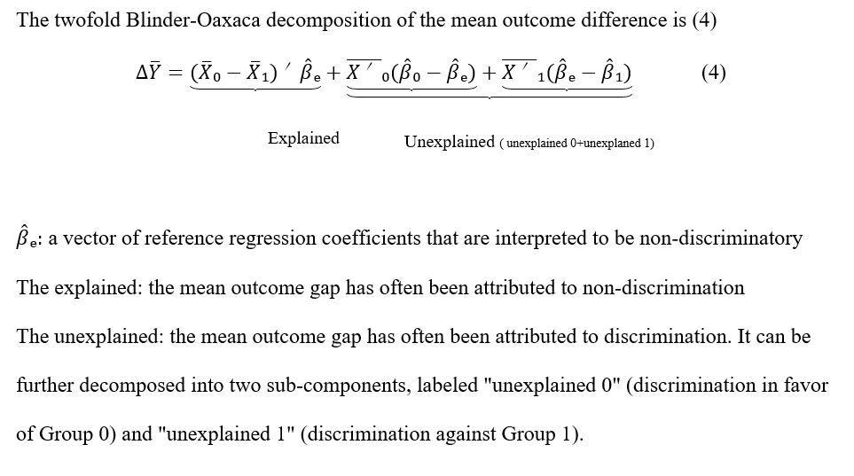
2.2.2 Introduction: Blinder-Oaxaca Decomposition
3
Twofold decomposition

Slide 21
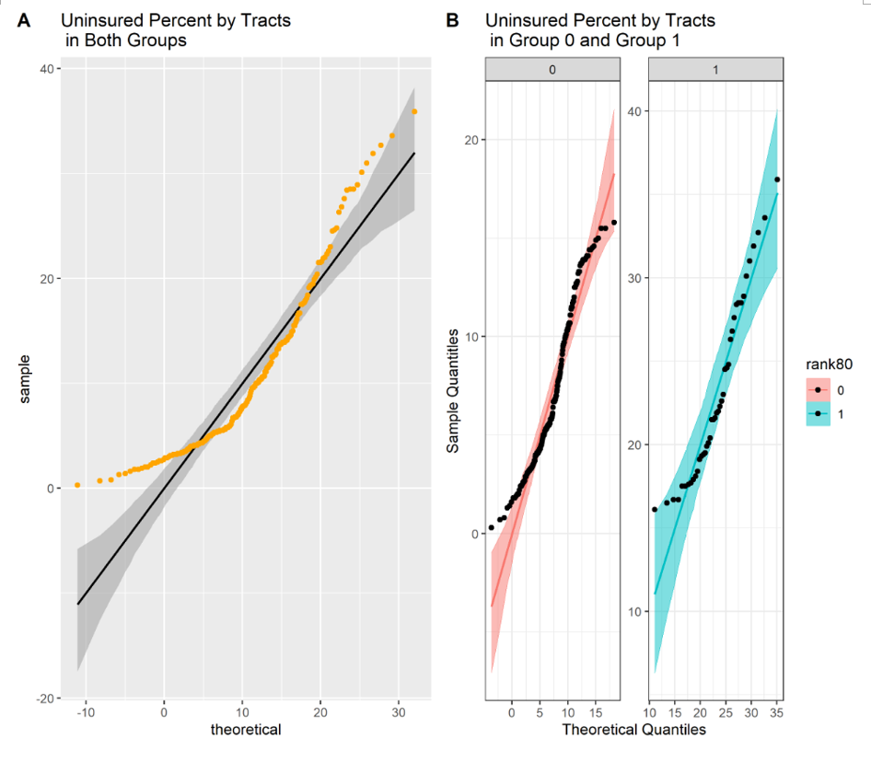
3 Problems and Solutions in Analysis
3.1
Problems
3.2
Solutions
Figure: Scatter Plots of Uninsured Percent by Tracts

Slide 22
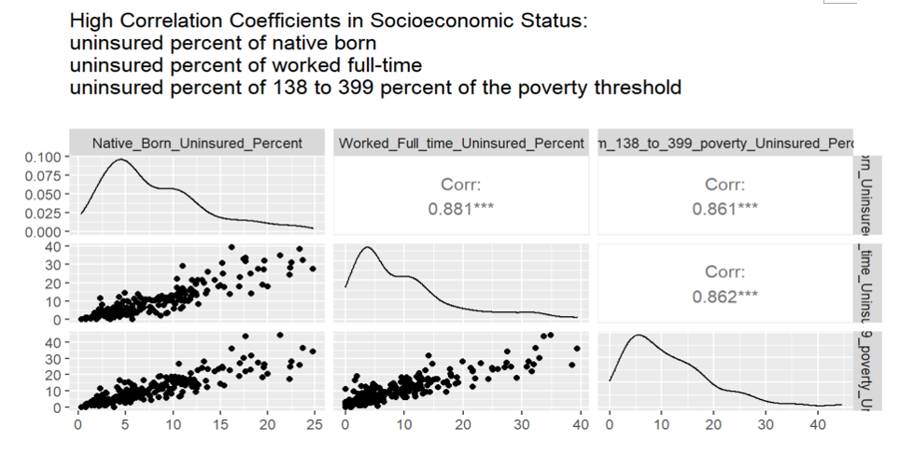
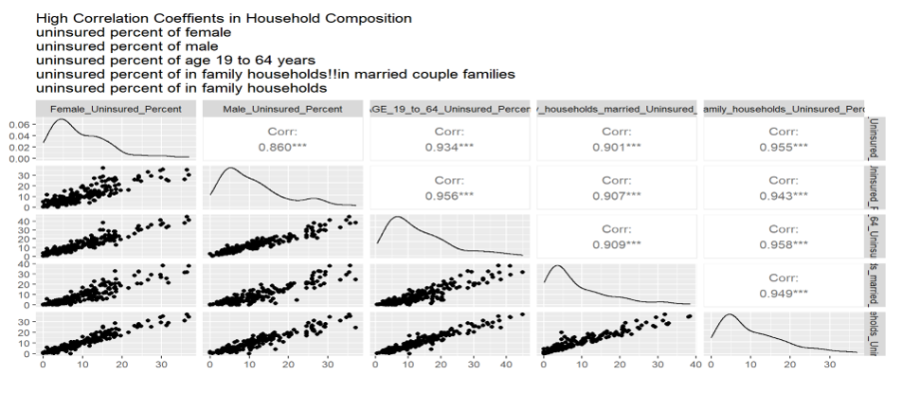
3.1.1 Problems (Highly Correlated Regressors)
In statistics, a regressor is a name given to any variable in a regression model that is used to predict a response variable. A regressor is also referred to as An explanatory variable. An independent variable. A manipulated variable. What is a Regressor? (Definition & Examples)
We have several regressors from different table which are highly correlated
Figure: High Correlation Coefficients in Socioeconomic Status
Figure: High Correlation Coefficients in Household Composition

Slide 23
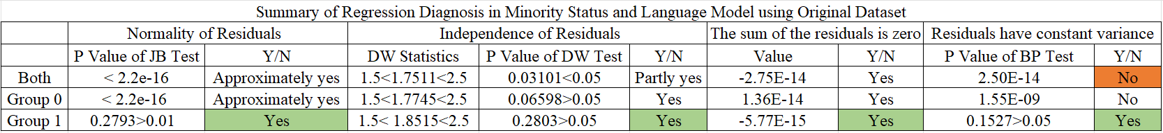
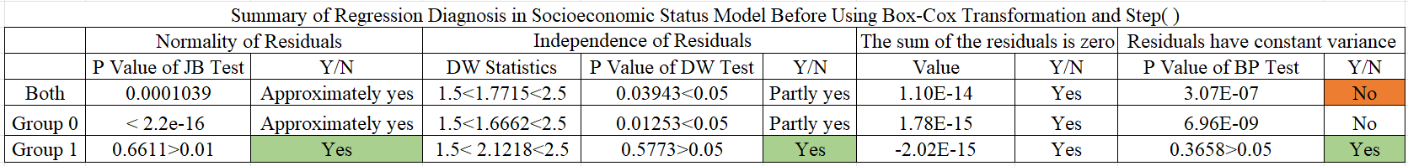
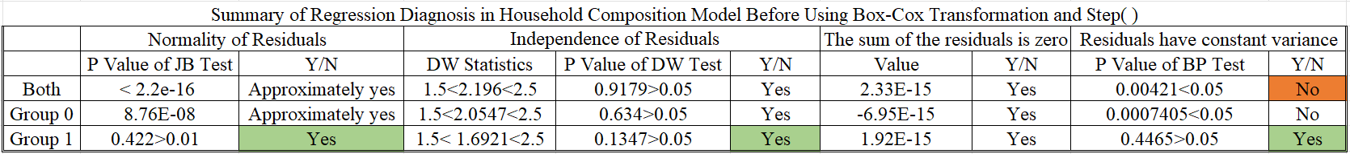
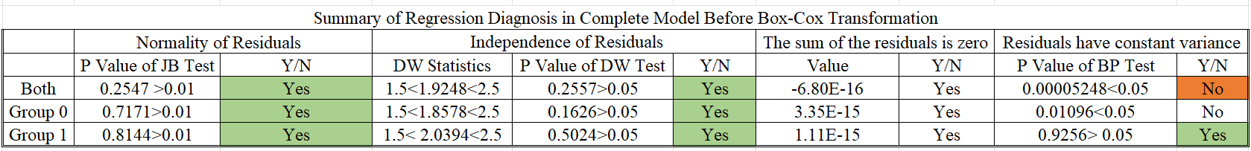
3.1.2 Problems (Heteroscedasticity of Residuals)
Notes:
In the minority status and language model, socioeconomic status model, household composition model, residuals are approximately normal and independent. In the complete (ADI) model, the residuals have passed the normality and independent tests. However, heteroscedasticity is always in all of the models. If we increase the number of independent variables of linear regression, the results of regression diagnosis improve.

Slide 24
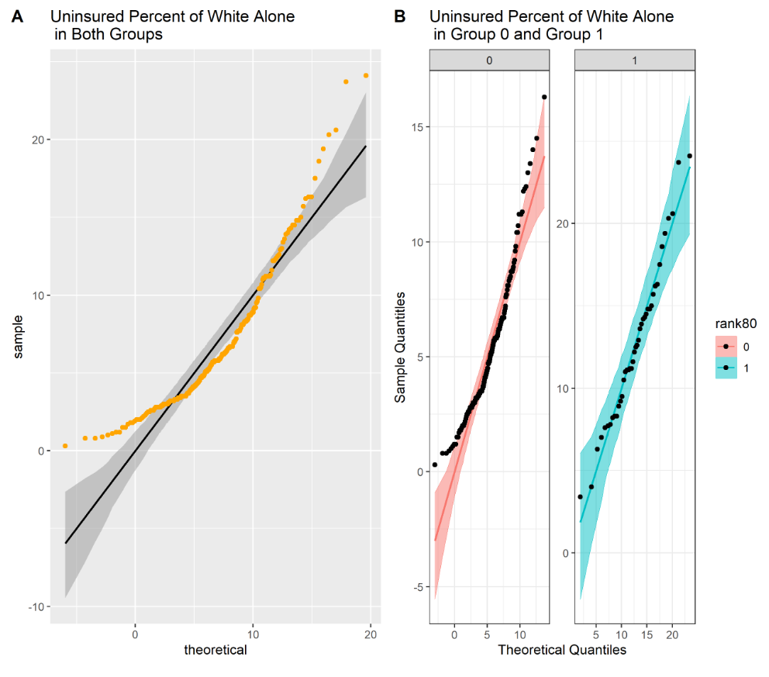
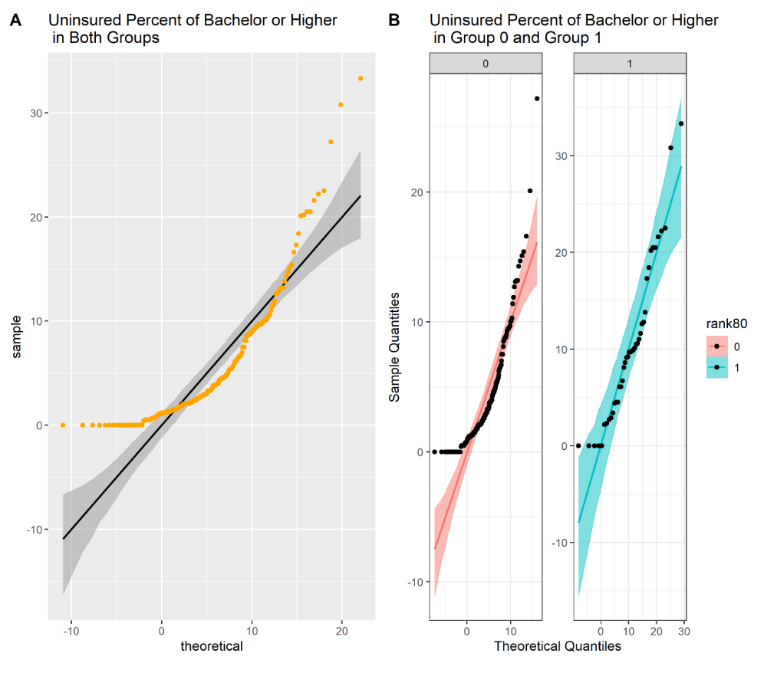
3.1.2 Problems (Heteroscedasticity of Residuals)
Notes:
As we can see from the scatter plots of the dataset in appendices A, B, C, and D, most of the points lie within the confidence bands in group 1, which is expected for the given distribution. However, we observe that there are many outliers in the scatter plots of both groups (group 0 and group 1) and group 0.
This is why residuals in group 1 pass normality, independence, and homoscedasticity tests in all four models. However, residuals in group 0 and both groups can’t pass homoscedasticity tests. Because our columns are from different datasets that describe various factors, heteroscedasticity is reasonable.

Slide 25
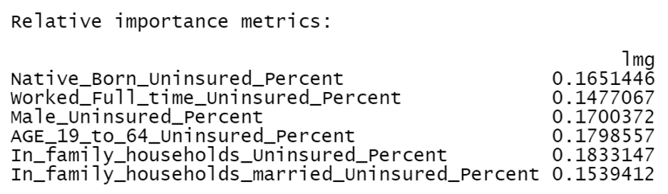
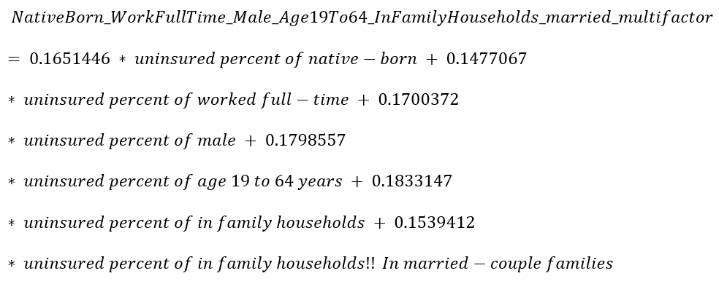
3.2.1 Solutions (Multicollinearity)
I adopt the method of the relative importance of regressors in linear models using the "relaimpo" package to find weights of the factors. The lmg metric provides a decomposition of the model explained variance into non-negative contributions.
I merge regressors whose correlation coefficients are higher than 0.85 into one column called "NativeBorn_WorkFullTime_Male_Age19To64_InFamilyHouseholds_married_multifactor" using this formula

Slide 26
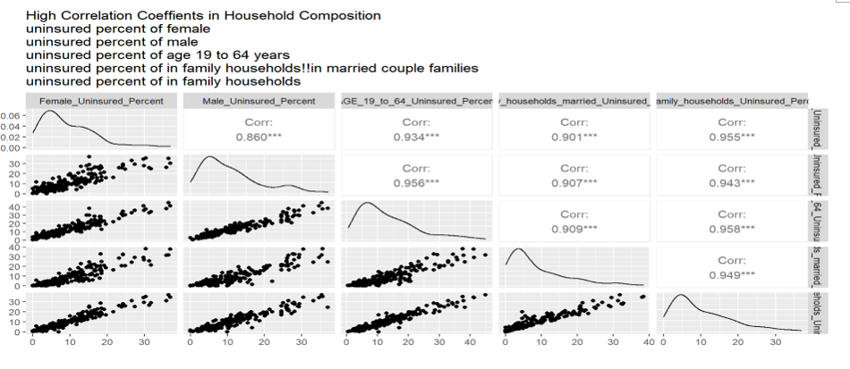
3.2.2 Solutions (Multicollinearity)
However, there are too many highly correlated regressors in the Household Composition model.
Figure: High Correlation Coefficients in Household Composition
I merge these factors above and generate a column called "Age19To64_Sex_InFamilyHousehold_married_multifactor“. I find that the correlation coefficient of uninsured percent of age under 19 years and Age19To64_Sex_InFamilyHousehold_married_multifactor is 0.8496210. I merge these two columns and generate a new column called “AgeTo64_Sex_InFamilyHousehold_married_multifactor2”

Slide 27
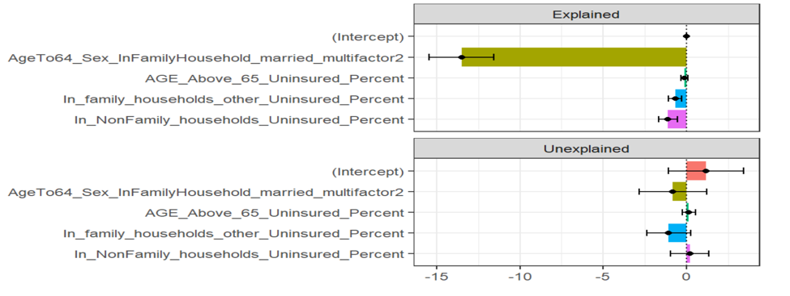
3.2.2 Solutions (Multicollinearity)
When I keep the names of regressors and use the relative importance of regressors two times, I’ve found that when we merge six factors into one factor, this doesn’t work well in Blinder-Oaxaca Decomposition.
It appears that none of the discrimination components account for the gap in uninsured percentage by tracts in the risk group and safe group.
Figure The explained and unexplained components of a twofold Blinder-Oaxaca decomposition of safe group 0 t vs. risk group 1 gap

Slide 28
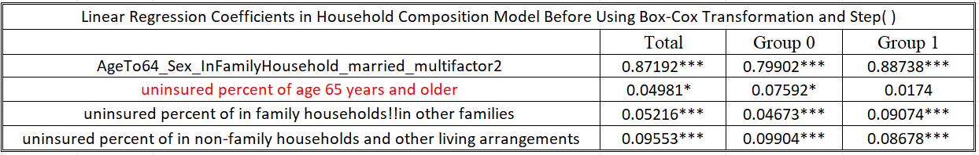
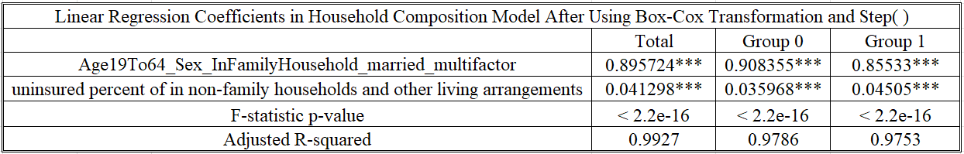
3.2.2 Solutions (Multicollinearity)
To avoid multicollinearity is the step() function which finds the best linear model with the least AIC. Step( ) removes some factors in the linear model which will not affect the final results of the Blinder-Oaxaca Decomposition.
We check if Step( ) removes the factors that have a significant impact on the final results. "uninsured percent of age 65 years and older” and “uninsured percent of age under 19 years”. The health insured status of age 65 years and older benefits from US Medicare and doesn’t have much effect on the gap of uninsured percentage by tracts in two groups. Other factors, for example, people under 19 depend on their parents for health insurance. These two factors do not have much effect on the health insurance market. Therefore, we adopt the factors which step() choose for us.

Slide 29
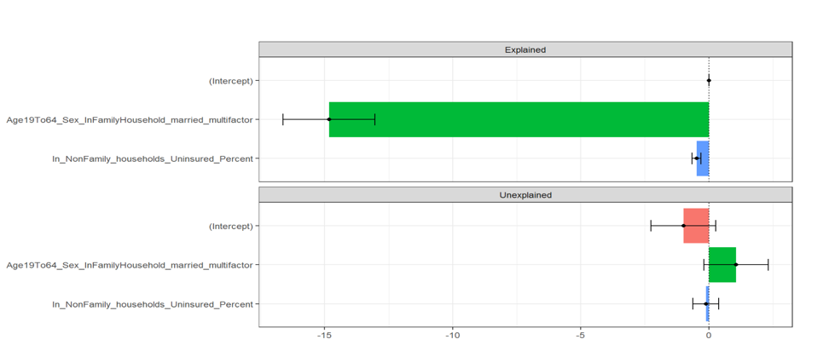
3.2.2 Solutions (Multicollinearity)
This is the twofold result of Blinder-Oaxaca Decomposition after we use step( ) and Box-Cox transformation.
From the figure below, we observe that the gap of uninsured percentage by tracts is driven largely by safe groups’ greater returns to the uninsured percentage of people who are from19 to 64 years old or live in family households or family households!! In married-couple families.
Figure The Explained and Unexplained Components of a Twofold Blinder-Oaxaca Decomposition of Safe Group 0 vs. Risk Group 1 Gap
After comparisons in different code versions, I use step( ) in the Socioeconomic Status model and the Household Composition model to fix the problem of multicollinearity. Then I merge the highly correlated factors after I use step ().

Slide 30
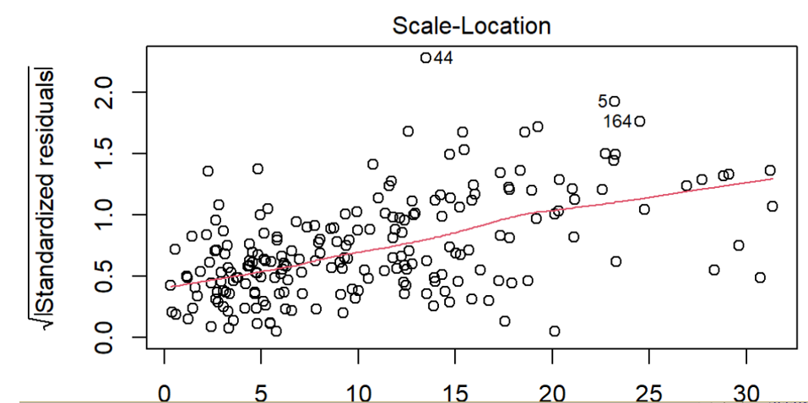
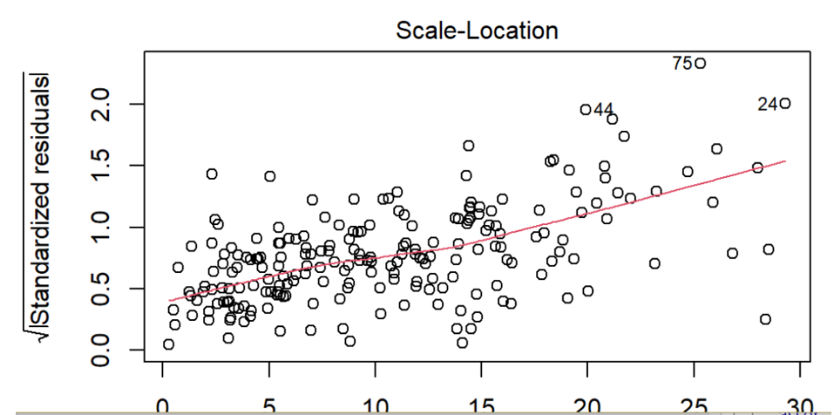
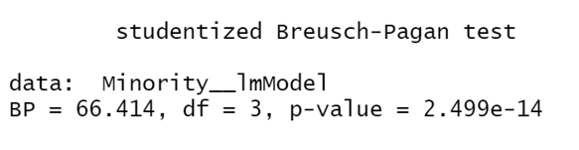
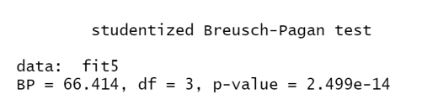
3.2.3 Solutions (Heteroscedasticity of Residuals)
Several ways to solve the problem of heteroscedasticity of residuals were tried. These are the residual plots of the original dataset vs weighted least squares estimation.
Figure Plots of Residuals in Minority Status Linear Regression Model Using Original Dataset
Figure Plots of Residuals in Minority Status Linear Regression Model using WLS
Figure BP Test Using Original Dataset
Figure BP Test Using Original Dataset
I have found the same p-value of the BP test. WLS doesn't work on heteroscedasticity.

Slide 31
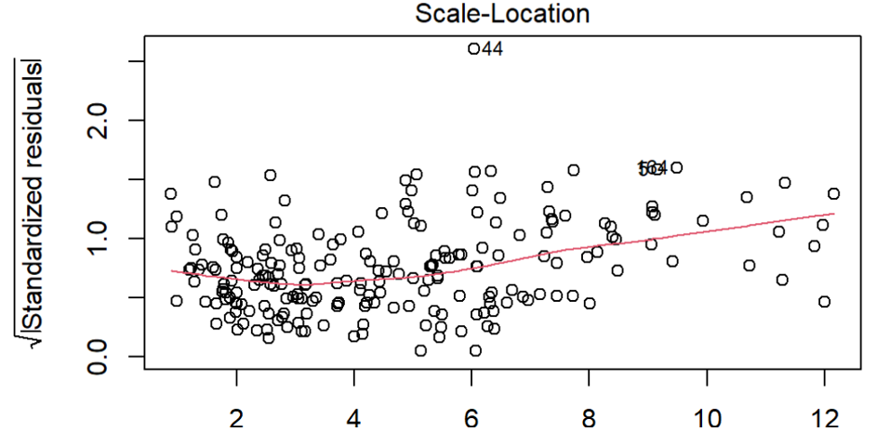
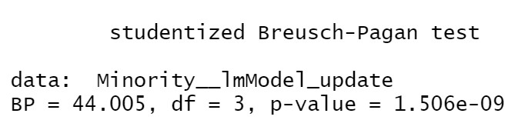
3.2.3 Solutions (Heteroscedasticity of Residuals)
Several ways to solve the problem of heteroscedasticity of residuals were tried. These are the residual plots of the original dataset vs Box-Cox Transformation.
Figure Plots of Residuals in Minority Status Linear Regression Model Using Original Dataset
Figure Plots of Residuals in Minority Status Linear Regression Model using Box-Cox Transformation
Figure BP Test Using Original Dataset
Figure BP Test Using Box-Cox Transformation
Box-Cox Transformation helps with increasing the P-value of BP test and reducing the level of heteroscedasticity of residuals. But it doesn't pass BP test.

Slide 32
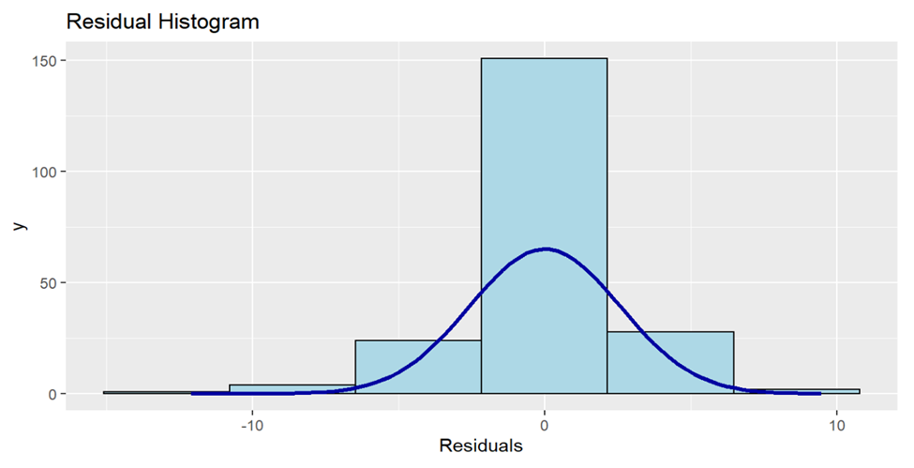
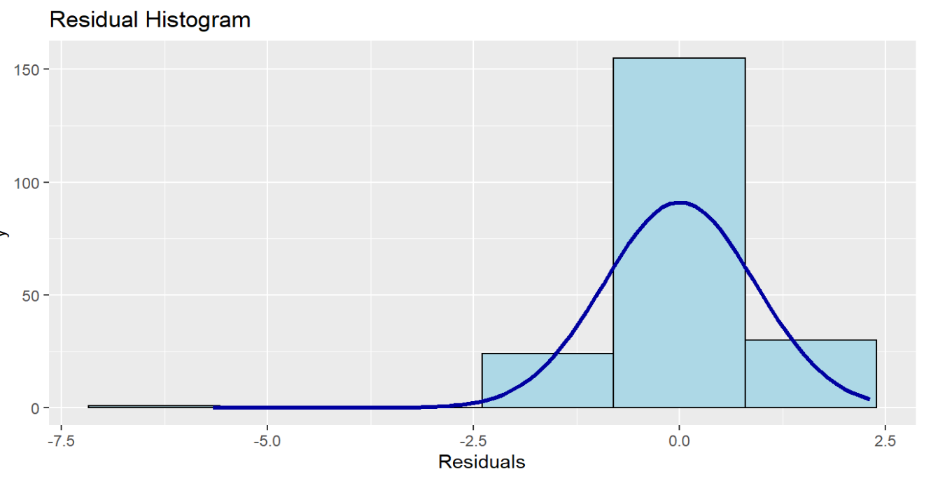
3.2.3 Solutions (Heteroscedasticity of Residuals)
I apply Box-Cox Transformation in the minority status model.
Figure Residual Histogram in Minority Status Using Original Dataset
Figure Residual Histogram in Minority Status using Box-Cox Transformation
The Histogram of the Residual can be used to check whether the variance is normally distributed. After Box-Cox transformation, the plot shows a symmetric bell-shaped histogram which is evenly distributed around zero within a smaller range.

Slide 33
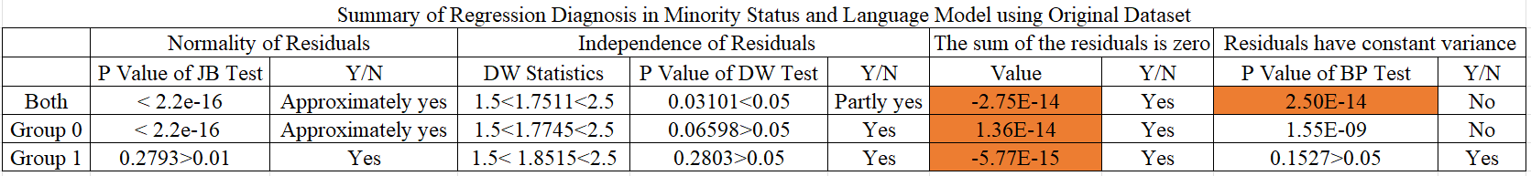
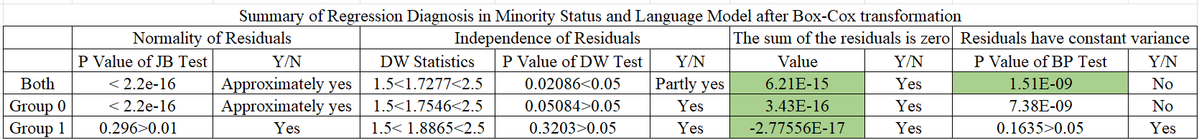
3.2.3 Solutions (Heteroscedasticity of Residuals)
Box-Cox Transformation in the minority status model makes the sum of the residuals more approximately zero.
To improve the test results of regression diagnosis, including normality, and homoscedasticity of residuals effectively, I have applied Box-Cox transformation in all of the four models of the project, the minority status and language model, the socioeconomic status model, the household composition model, and the complete (ADI) model.

Slide 34
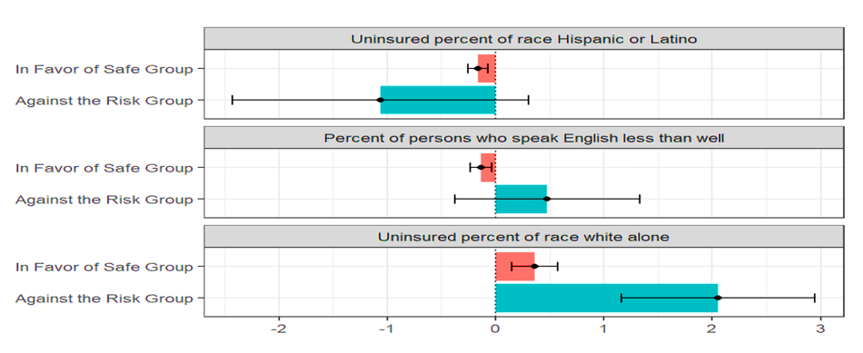
4 Empirical Research
4.1
The Minority Status and Language Model
4.2
The Socioeconomic Status Model
4.3
The Household Composition Model
4.4
The Complete (ADI) Model
Figure The Unexplained Portion's Discrimination Sub-Components in a Twofold Blinder-Oaxaca Decomposition of Safe Group 0 vs. Risk Group 1 Gap (The Minority Status and Language Model)

Slide 35
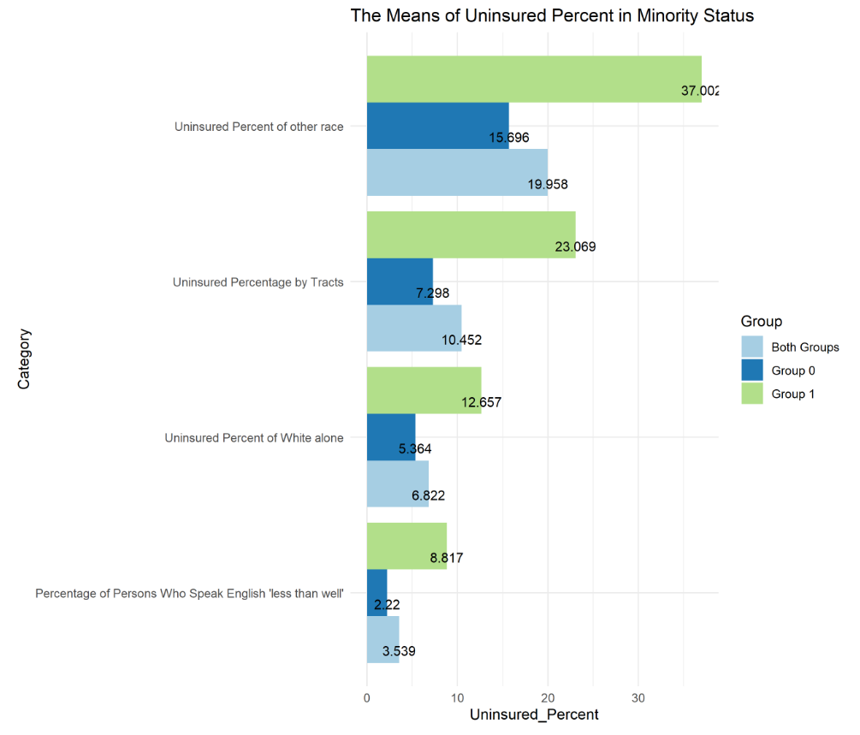
4.1.1 The Minority Status and Language Model
1
Descriptive Statistics of Minority Status(%)
Minority status and language contain race and English language proficiency variables. It includes three influencing factors: uninsured percent of Hispanic or Latino (of any race), uninsured percent of White alone (not Hispanic or Latino), and the percentage of persons who speak English "less than well."
We have found obvious health disparities in the race.
The means of uninsured percent of white alone are lower than the means of uninsured percentage by tracts in total, group 0 and group 1.
However, the means of uninsured percent of Hispanics or Latino (of any race) are higher than the means of uninsured percentage by tracts in total, group 0 and group 1.
The health insured status of white alone is better than that of other races.

Slide 36
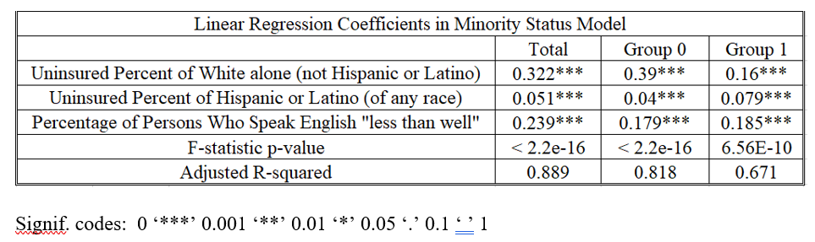
4.1.2 The Minority Status and Language Model
2
Linear Regression
Linear regression results of the minority status model after the Box-Cox transformation is applied
All of the influencing factors affect uninsured percent by tracts in both groups, group 0 and group 1.
F-statistic p-values mean that the regression model fits the data better than the model with no independent variables.
Adjusted R-squared: 0.8889 and 0.8183 Goodness-of-fit measure.
Because the project's goal is how influence factors impact uninsured percentage by tracts rather than predictions, the small R-squared value of 0.671 will not affect the results.

Slide 37
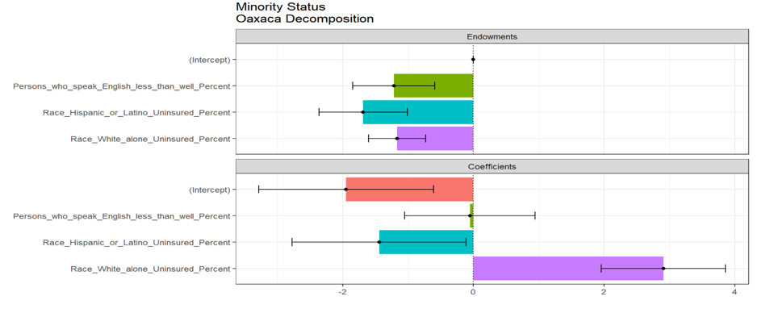
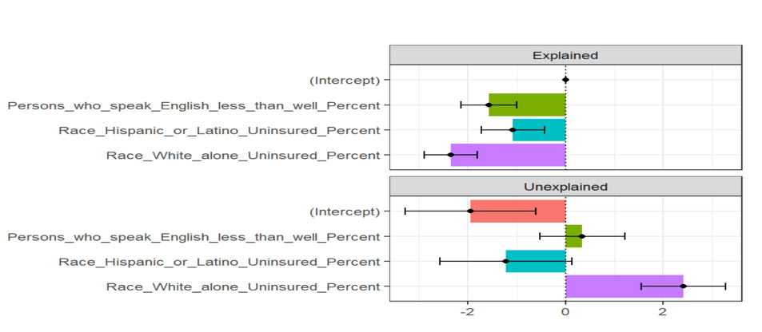
4.1.3 The Minority Status and Language Model
3
Blinder-Oaxaca decomposition
Figure The Explained and Unexplained Components of a Twofold Blinder-Oaxaca Decomposition of Safe Group 0 vs. Risk Group 1 Gap
Figure Plot of the Threefold Decomposition of Minority Status Model
The threefold decomposition result shows that differences in the regression coefficients on the uninsured percentage of white alone account for the decisive portion of the uninsured percentage by tracts gap in minority status and language model.
The twofold decomposition result demonstrates that the returns to the uninsured percentage of white alone and the percentage of persons who speak English less than well are more significant for the risk group than for the safe group.
Those results make some intuitive sense if we interpret the uninsured percentage of white alone and the percentage of persons who speak English less than well, potentially picking up the effect of the health insurance market in Salt Lake County experience.

Slide 38
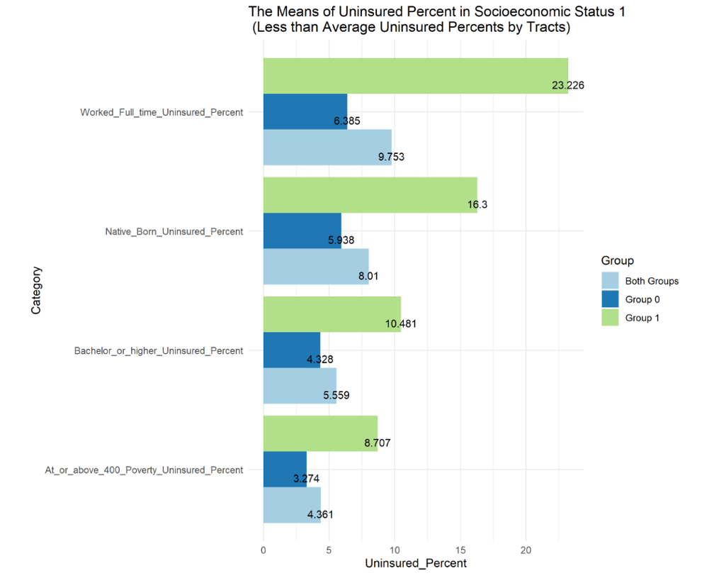
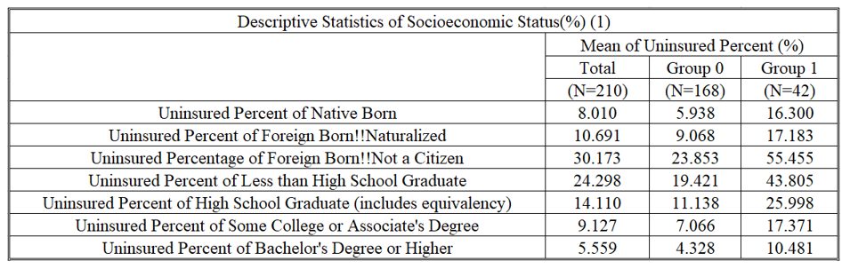
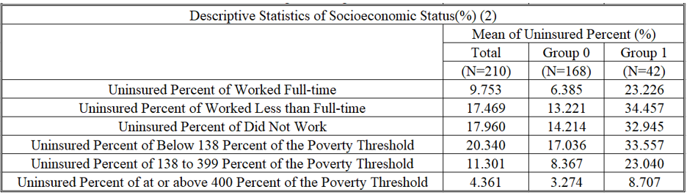
4.2.1 The Socioeconomic Status Model
1
Descriptive Statistics of Socioeconomic Status Model (%)
The means of uninsured percent of native-born, uninsured percent of bachelor’s degree or higher, uninsured percent of working full-time, uninsured percent of at or above 400 percent of the poverty threshold are lower than the means of uninsured percentage by tracts in total, group 0 and group 1.
The health insured status of native-born, Bachelor's degree or higher, worked full-time, at or above 400 percent of the poverty threshold are better than the other types of people.

Slide 39
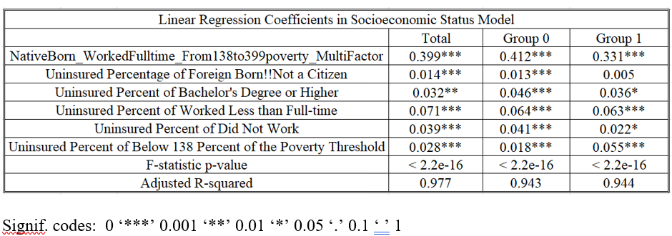
4.2.2 The Socioeconomic Status Model
2
Linear Regression
The linear regression results of the socioeconomic status model applied Step( ), the method of the relative importance of regressors in linear models, and the Box-Cox transformation.
All of the influencing factors affect uninsured percent by tracts.
F-statistic p-values mean that the regression model fits the data better than the model with no independent variables.
The values of adjusted R-squared show Goodness-of-fit.

Slide 40


4.2.3 The Socioeconomic Status Model
3
Blinder-Oaxaca decomposition
Figure The Explained and Unexplained Components of a Twofold Blinder-Oaxaca Decomposition of Safe Group 0 vs. Risk Group 1 Gap
Figure Plot of the Threefold Decomposition of Socioeconomic Status Model

Slide 41
4.2.3 The Socioeconomic Status Model
3
Blinder-Oaxaca decomposition
The threefold decomposition result shows differences in the regression coefficients on the uninsured percentage of native-born people, full-time jobs, or 138 and 399 percent of the poverty threshold account for the most significant portion of the uninsured percentage tracts gap in the socioeconomic status model.
Twofold decomposition results demonstrate that the returns to the uninsured percentage of people who are native-born or have full-time jobs or are in the range of 138 and 399 percent of the poverty threshold, uninsured percentage of foreign-born‼ not a citizen, uninsured percent of worked less than full-time, uninsured percent of did not work are greater for risk group than for the safe group.
Those results make some intuitive sense if we interpret the uninsured percentage of employment status, in the range of 138 and 399 percent of the poverty threshold, native-born, and bachelor's degree or higher as potentially picking up the effect of the health insurance market in Salt Lake County experience.

Slide 42


4.3.1 The Household Composition Model
1
Descriptive Statistics of The Household Composition Model (%)
We have found that the means of uninsured percent of females, uninsured percent of age under 19 years, uninsured percent of age 65 years and older, uninsured percent in family households!! In married couples, uninsured percent in family households!! are lower than the means of the uninsured percentage by tracts in total, groups 0 and 1.
The health insured status of age 65 years and older is better than the one of other factors—this type of person benefits from US Medicare.

Slide 43

4.3.2 The Household Composition Model
2
Linear Regression
This is the linear regression results of the household composition model after I applied Step( ), the method of the relative importance of regressors in linear models, and the Box-Cox transformation.
All of the influencing factors affect uninsured percent by tracts.
F-statistic p-values mean that the regression model fits the data better than the model with no independent variables.
The values of adjusted R-squared show Goodness-of-fit.

Slide 44


4.3.3 The Household Composition Model
3
Blinder-Oaxaca decomposition
Figure Plot of the Threefold Decomposition of The Household Composition Model
Figure The Explained and Unexplained Components of a Twofold Blinder-Oaxaca Decomposition of Safe Group 0 vs. Risk Group 1 Gap

Slide 45
4.3.3 The Household Composition Model
3
Blinder-Oaxaca decomposition
We have found that the uninsured percentage of females and that of males are highly correlated. But the means of uninsured percentages of females are lower than the ones of males. And the datasets of the project provide information at the census tract level. I hold that health inequity stems from income inequity rather than discrimination on sex here. All of the influencing factors affect uninsured percentage by tracts in both groups except the factor of uninsured percent of age 65 years and older because people aged 65 years and older benefit from US Medicare and are not impacted by the tracts they live in.
The threefold decomposition result shows differences in the regression coefficients on the uninsured percentage of people who are from19 to 64 years old or live in family households or family households!! In married-couple families account for the decisive portions of the uninsured percentage by tracts gap.
Twofold decomposition results demonstrate that the returns to the uninsured percentage of people who are from19 to 64 years old or live in family households or family households!! In married-couple families are more significant for the risk group than for the safe group.
Those results make some intuitive sense if we interpret the uninsured percentage of people who are from19 to 64 years old or live in family households as potentially picking up the effect of the health insurance market in Salt Lake County experience.

Slide 46


4.4.1 The Complete (ADI) Model
1
Descriptive Statistics of the Complete (ADI) Model (%)
Complete (ADI) Model contains all of the influencing factors included in the models above (minority status model, socioeconomic status model, household composition model). And I added ADI80, which indicates the most disadvantaged neighborhood groups as group 1 and others as 0. In this model, we have 209 tracts because there is a missing value in ADI state rank.
We can find that the most disadvantaged neighborhood tracts are highly correlated with the risk tracts with a high uninsured percentage. The means in ADI state rank and ADI80 are higher in group 1 than in group 0. And the higher values in ADI mean more disadvantaged neighborhood tracts. There are 167 tracts in the safe group 0 and 42 tracts in the risk group 1. And we observe that there are 39 most disadvantaged neighborhood tracts and 170 other tracts. The numbers of tracts in different classifications are very close. And the means of tracts in different classifications/groups are very close too.

Slide 47


4.4.2 The Complete (ADI) Model
2
Linear Regression
This is the linear regression results of the complete (ADI) model after I applied the method of the relative importance of regressors in linear models and the Box-Cox transformation.
All of the influencing factors affect uninsured percent by tracts.
F-statistic p-values mean that the regression model fits the data better than the model with no independent variables.
The values of adjusted R-squared show Goodness-of-fit.

Slide 48


4.4.3 The Complete (ADI) Model
3
Blinder-Oaxaca decomposition
Figure Plot of the Threefold Decomposition of The Complete (ADI) Model
Figure The Explained and Unexplained Components of a Twofold Blinder-Oaxaca Decomposition of Safe Group 0 vs. Risk Group 1 Gap

Slide 49
4.4.3 The Complete (ADI) Model
3
Blinder-Oaxaca decomposition
We have found apparent health disparities in the complete model. Threefold decomposition result shows that differences in the regression coefficients on the uninsured percentage of white alone, uninsured percentages of Bachelor's degree or higher, uninsured percent of people who are native-born or age from 19 to 64, or live in family households or have full-time work or less than full-time work account for the portions of the uninsured percentage by tracts gap in the complete model. Twofold decomposition results show that the returns to the uninsured percentage of white alone, uninsured percentages of Bachelor's degree or higher, uninsured percent of people who are native-born or age from 19 to 64, or in family households, or have full-time work or less than full-time work are greater for the risk group than for the safe group.
After comparing the minority status and language model, socioeconomic status model, household composition model with the complete model, I maintain that we interpret the uninsured percentage of white alone, uninsured percentage of a native-born, uninsured percentage of worked full-time, uninsured percent of bachelor’s degree or higher as potentially picking up the effect of the health insurance market in Salt Lake County experience. Other factors are the uninsured percentage of people who are from19 to 64 years old or live in family households have an impact on the gap of uninsured percentage by tracts in the risk group and the safe group.
We notice that the uninsured percentage of native-born, uninsured percentage of worked full-time, uninsured percentage of people in the range of 138 and 399 percent of the poverty threshold are highly correlated. It suggests that if the uninsured percentage of full-time workers decreases, the uninsured percentage of people in the range of 138 and 399 percent of the poverty threshold goes down. Their fluctuations change the uninsured percentage of native-born in the same direction.

Slide 50
5 Discussion
5.1
We choose variables based on common sense.
It is possible that other valuable factors are not collected in the project.
We haven’t found the uninsured percentages about career types from ACS 5.
5.2
Heteroscedasticity and Subjective Ideas of Data Transformation
Because of heteroscedasticity and subjective ideas of data transformation, the results are not correct, although they look reasonable.
In future work, we could make data analysis on segments, for example, the first 20th percentile of the dataset, the last 20th percentile of the dataset, and the middle between them, to avoid too many outliers and improve correctness.

Slide 51
6 Conclusions
1. In the empirical research on uninsured percentage by tracts in Salt Lake County, we have found a 15.7% gap between the risk group (23%) and the safe group (7.3%). I hold that health inequity stems from income inequity.
the uninsured percentage of white alone /native-born /worked full-time /bachelor’s degree or higher /live in family households impact the uninsured percentage by tracts more greatly on the risk group than on the safe group.
2. To change the unbalanced status quo, I maintain that:
Strengthening higher education /Creating new full-time job opportunities /Building harmonious relationships with family members for their support
3. I expect people in Salt Lake County to embrace a more healthcare equitable society right.

Slide 52
7 References
1. Whitehead, M. "The concepts and principles of equity and health." International journal of health services : planning, administration, evaluation vol. 22,3 (1992): 429-45. doi:10.2190/986L-LHQ6-2VTE-YRRN
2. Garfield, Rachel and Tolbert, Jennifer. "What We Do and Don't Know About Recent Trends in Health Insurance Coverage in the US." KFF, 17 Sept. 2020, www.kff.org/policy-watch/what-we-do-and-dont-know-about-recent-trends-in-health-insurance-coverage-in-the-us.
3. Rollins, Jenny. "Utah Has One of the Highest Rates of Uninsured Kids. Could Insuring Them Save Taxpayers Millions?" KSL.Com, Oct 7 2021, www.ksl.com/article/50256885/Utah-has-one-of-the-highest-rates-of-uninsured-kids-could-insuring-them-save-taxpayers-millions.
4. Alker, Joan, and Alexandra Corcoran. "Children's Uninsured Rate Rises by Largest Annual Jump in More Than a Decade." Ccf.Georgetown.Edu, Oct. 2020, ccf.georgetown.edu/wp-content/uploads/2020/10/ACS-Uninsured-Kids-2020_10-06-edit-3.pdf.
5. "CDC SVI 2018 Documentation." Atsdr.Cdc.Gov, Jan 31 2020, www.atsdr.cdc.gov/placeandhealth/svi/documentation/pdf/SVI2018Documentation-H.pdf.
6. "CDC/ATSDR Social Vulnerability Index." ATSDR, www.atsdr.cdc.gov/placeandhealth/svi/index.html. Accessed Mar 11. 2022.
7. "About the Area Deprivation Index (ADI)." Neighborhood Atlas, www.neighborhoodatlas.medicine.wisc.edu. Accessed Mar 12 2022.
8. Hlavac, Marek. “Oaxaca: Blinder-Oaxaca Decomposition in R.” SSRN, 20 Nov. 2014, https://papers.ssrn.com/sol3/papers.cfm?abstract_id=2528391.
9. Hlavac, Marek (2018). oaxaca: Blinder-Oaxaca Decomposition in R. R package version
0.1.4. https://CRAN.R-project.org/package=oaxaca
10. "Lecture 12 Heteroscedasticity." Bauer, www.bauer.uh.edu/rsusmel/phd/ec1-12.pdf.
Accessed Mar 12 2022.

Slide 53
7 References
11. Zach. "How to Interpret a Scale-Location Plot (With Examples)." Statology, Nov 25 2020, www.statology.org/scale-location-plot.
12. "Package 'Relaimpo.'" R Official Website, Oct 20. 2021,
cran.r-project.org/web/packages/relaimpo/relaimpo.pdf.
13. "Further Residual Plot Examples." PSU, online.stat.psu.edu/stat462/node/124. Accessed Mar 14. 2022.
14. "Salt Lake City, Utah Population 2022." World Population Review, worldpopulationreview.com/us-cities/salt-lake-city-ut-population. Accessed Mar 15 2022.
15. “What Is a Box Cox Transformation?” Statistics How To, www.statisticshowto.com/box-cox-transformation. Accessed 25 Mar. 2022.
16. “Psychologists Love To Report ‘Marginally Significant’ Results, According To A New Analysis.” The British Psychological Society, digest.bps.org.uk/2019/03/12/psychologists-love-to-report-marginally-significant-results-according-to-a-new-analysis. Accessed 4 Apr. 2022.
17. Lew, Nancy, et al. “A Layman’s Guide to the U.S. Health Care System.” NCBI, 1992, www.ncbi.nlm.nih.gov/pmc/articles/PMC4193322.
18. “Step: Choose a Model by AIC in a Stepwise Algorithm.” RDocumentation Search All Packages and Functions, www.rdocumentation.org/packages/stats/versions/3.6.2/topics/step. Accessed 5 Apr. 2022.
19. Keisler-Starkey, Katherine, and Lisa Bunch. “Health Insurance Coverage in the United States: 2020.” United States Census Bureau, 14 Sept. 2021, www.census.gov/library/publications/2021/demo/p60-274.html.

Slide 54
Author Contributions: Thank you to Ray Hoobler, Ph.D., for the guidance on the reports. Conflicts of Interest: The authors declare no conflict of interest. Sponsor Information The Professional Master of Science and Technology program Ray Hoobler, Ph.D. Ray.Hoobler@utah.edu 801-585-5630

